Slide 1
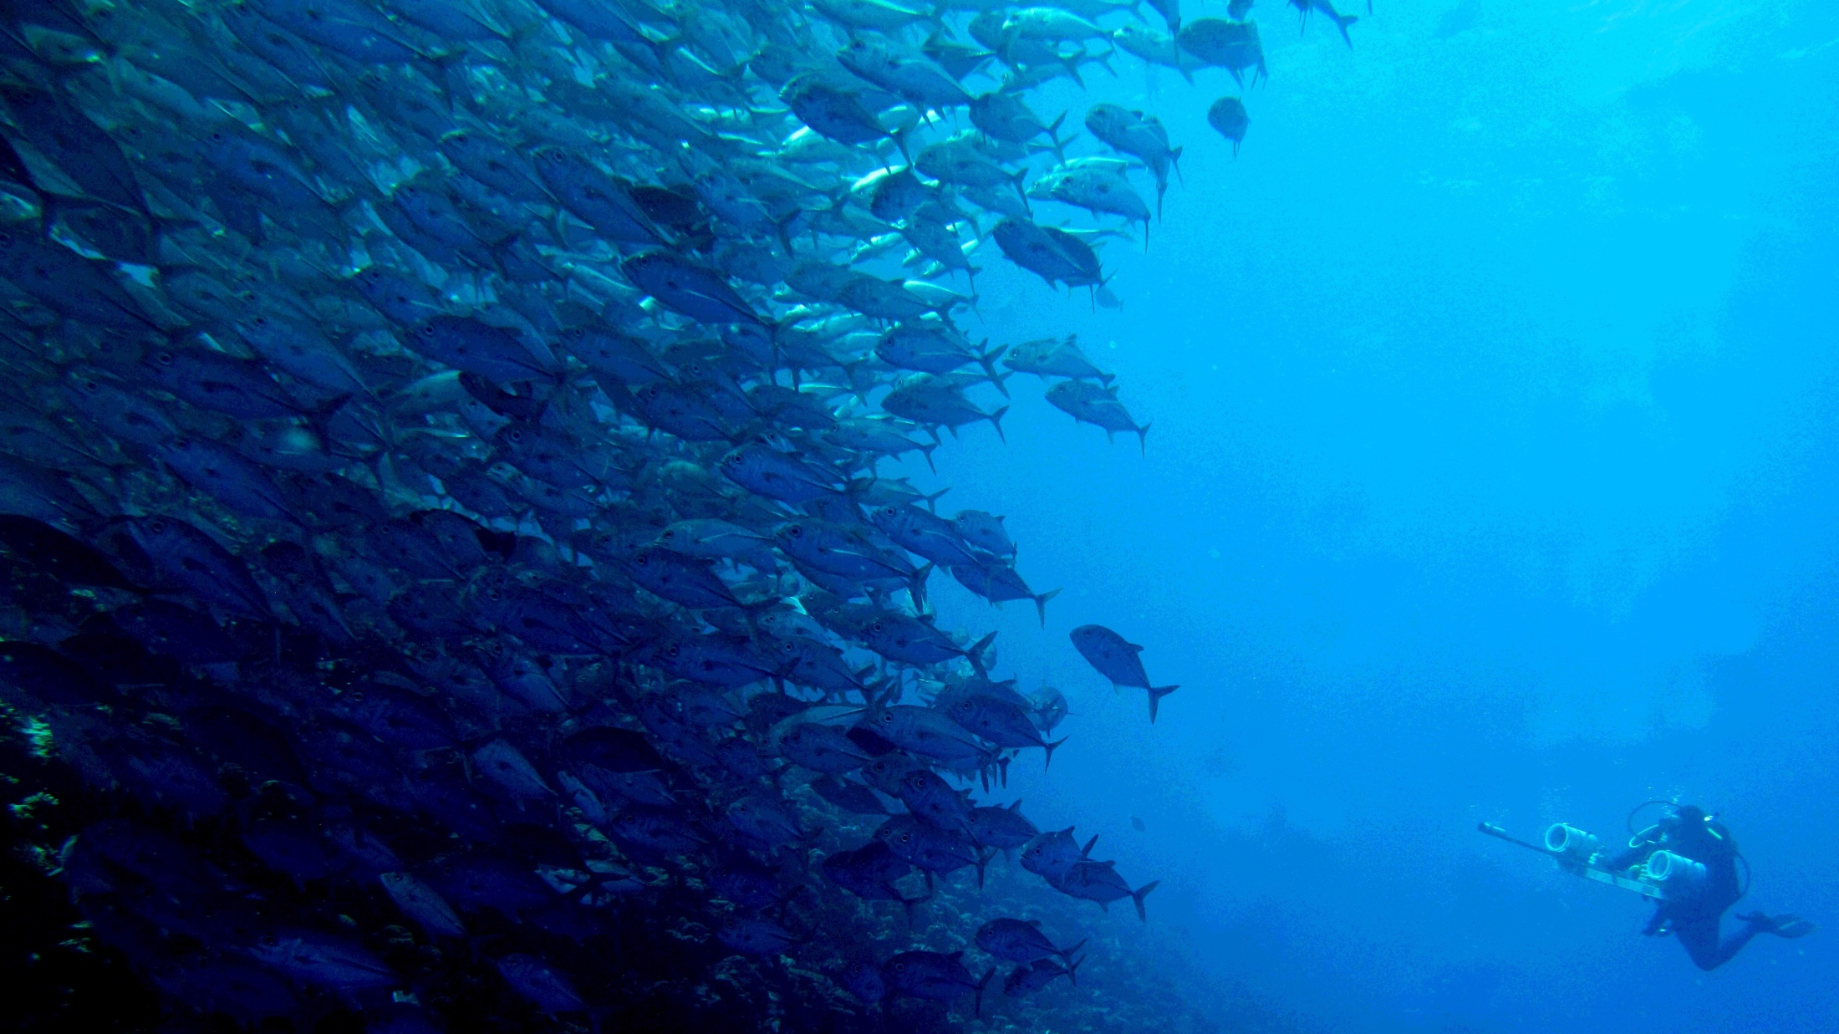
Apex predators and human populations as structuring agents on coral reefs
Jonathan L.W. Ruppert, Laurent Vigliola, Marie-Josée Fortin and Mark G. Meekan

Slide 2
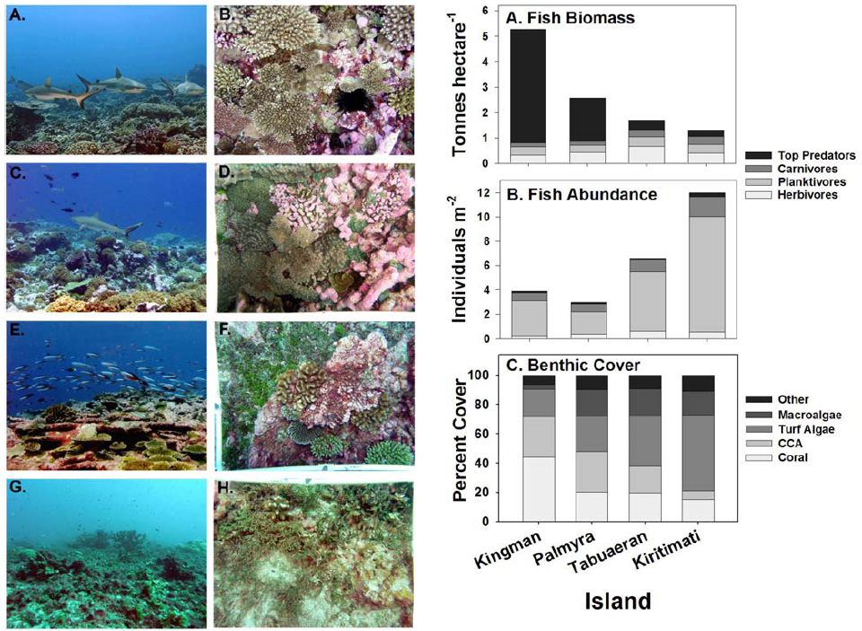
Local Scale: Human demography and sharks
Fish Community
Benthic Cover
Low Human
Population
Density
High Shark
Biomass
Low Shark
Biomass
High Human
Population
Density
Sandin et al. 2008 PLoS ONE
Notes:
In remote pacific regions, including the Hawaiin Islands and the Line Islands recent studies have demonstrated from a snapshot perspective (that is from fine temporal scales) that top predators can have wide ranging effects on ecosystem functioning
Here I am showing the results from the effects of top predator declines on the Line Islands
Trends in body size of individuals were also seen across these islands depending on consumer guild (predators largest:Kingman; smallest: kirimati AND planktivores were the inverse)
The association of community structure and function with top predator biomass is striking, but the major criticism with this study as I mentioned before is that it has a fine temporal scale so it does not account for variability in species abundance and biomass
Results may also be linked to other phenomena, such as human population density, pollution, sedimentation, etc.
The generality of this pattern is a point of contention mainly due to the temporal scope of the two studies and that it has only been shown to occur in remote regions of the pacific

Slide 3

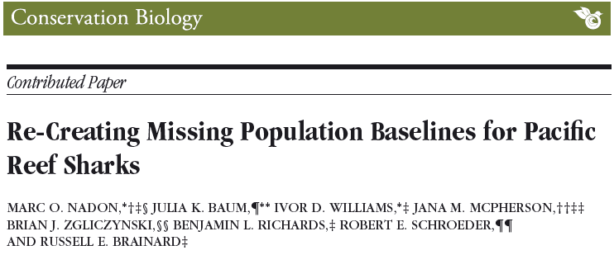
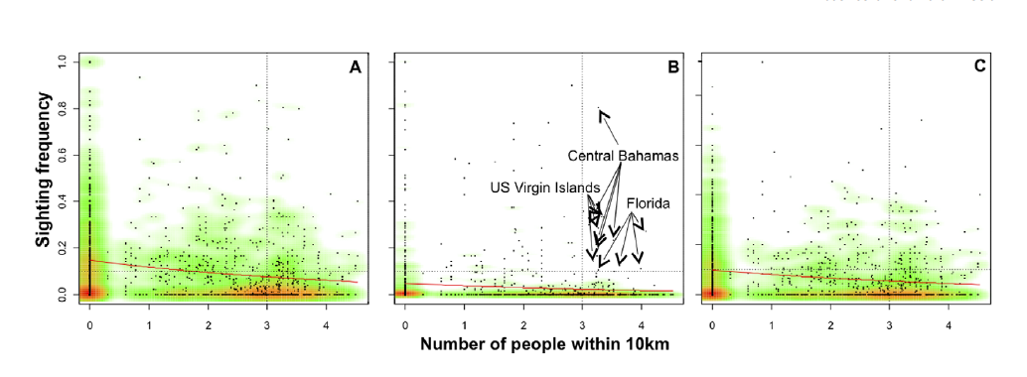
  Broad Scale: A Negative Relationship
Inverse Power Models
Notes:
Previous broad scale work uses human demography as a proxy and points to an overall negative relationship between humans and sharks
The models used here are aspatial, meaning that this relationship is a global estimate across all sites
The more recent paper attempts to incorporate environmental and habitat factors but in a limited extent

Slide 4
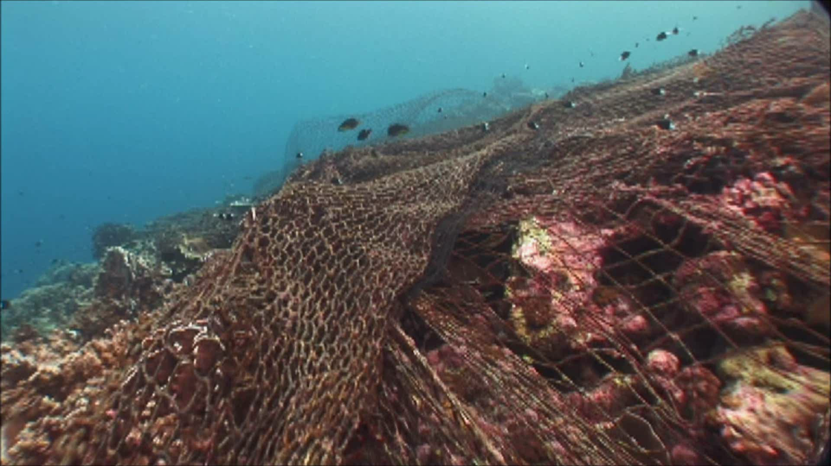
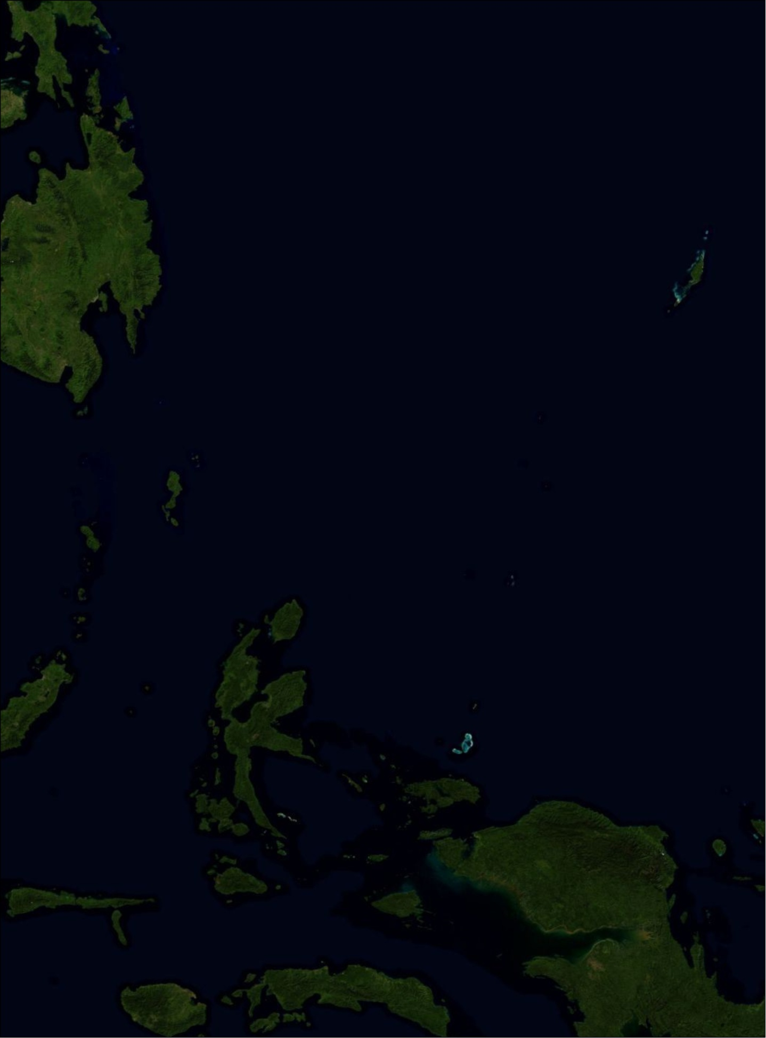
  Remote Reefs & Marine Protected Areas
Philippines
Palau
Pulo Anna
Indonesia
Notes:
One of the things that comes out of these and other papers is that remote and/or protected reefs may be more pristine
Being remote and protected is not enough
And here is an example

Slide 5
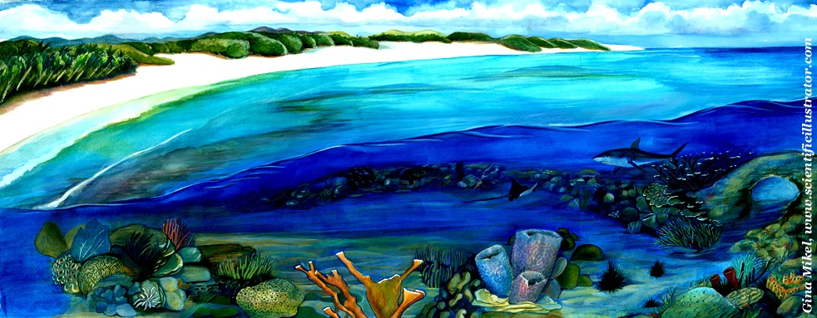
Objectives
What factors are important to the distribution of reef sharks throughout the Pacific?
How does space influence these relationships?
How does the significance and strength of these interactions impact fish communities?

Slide 6
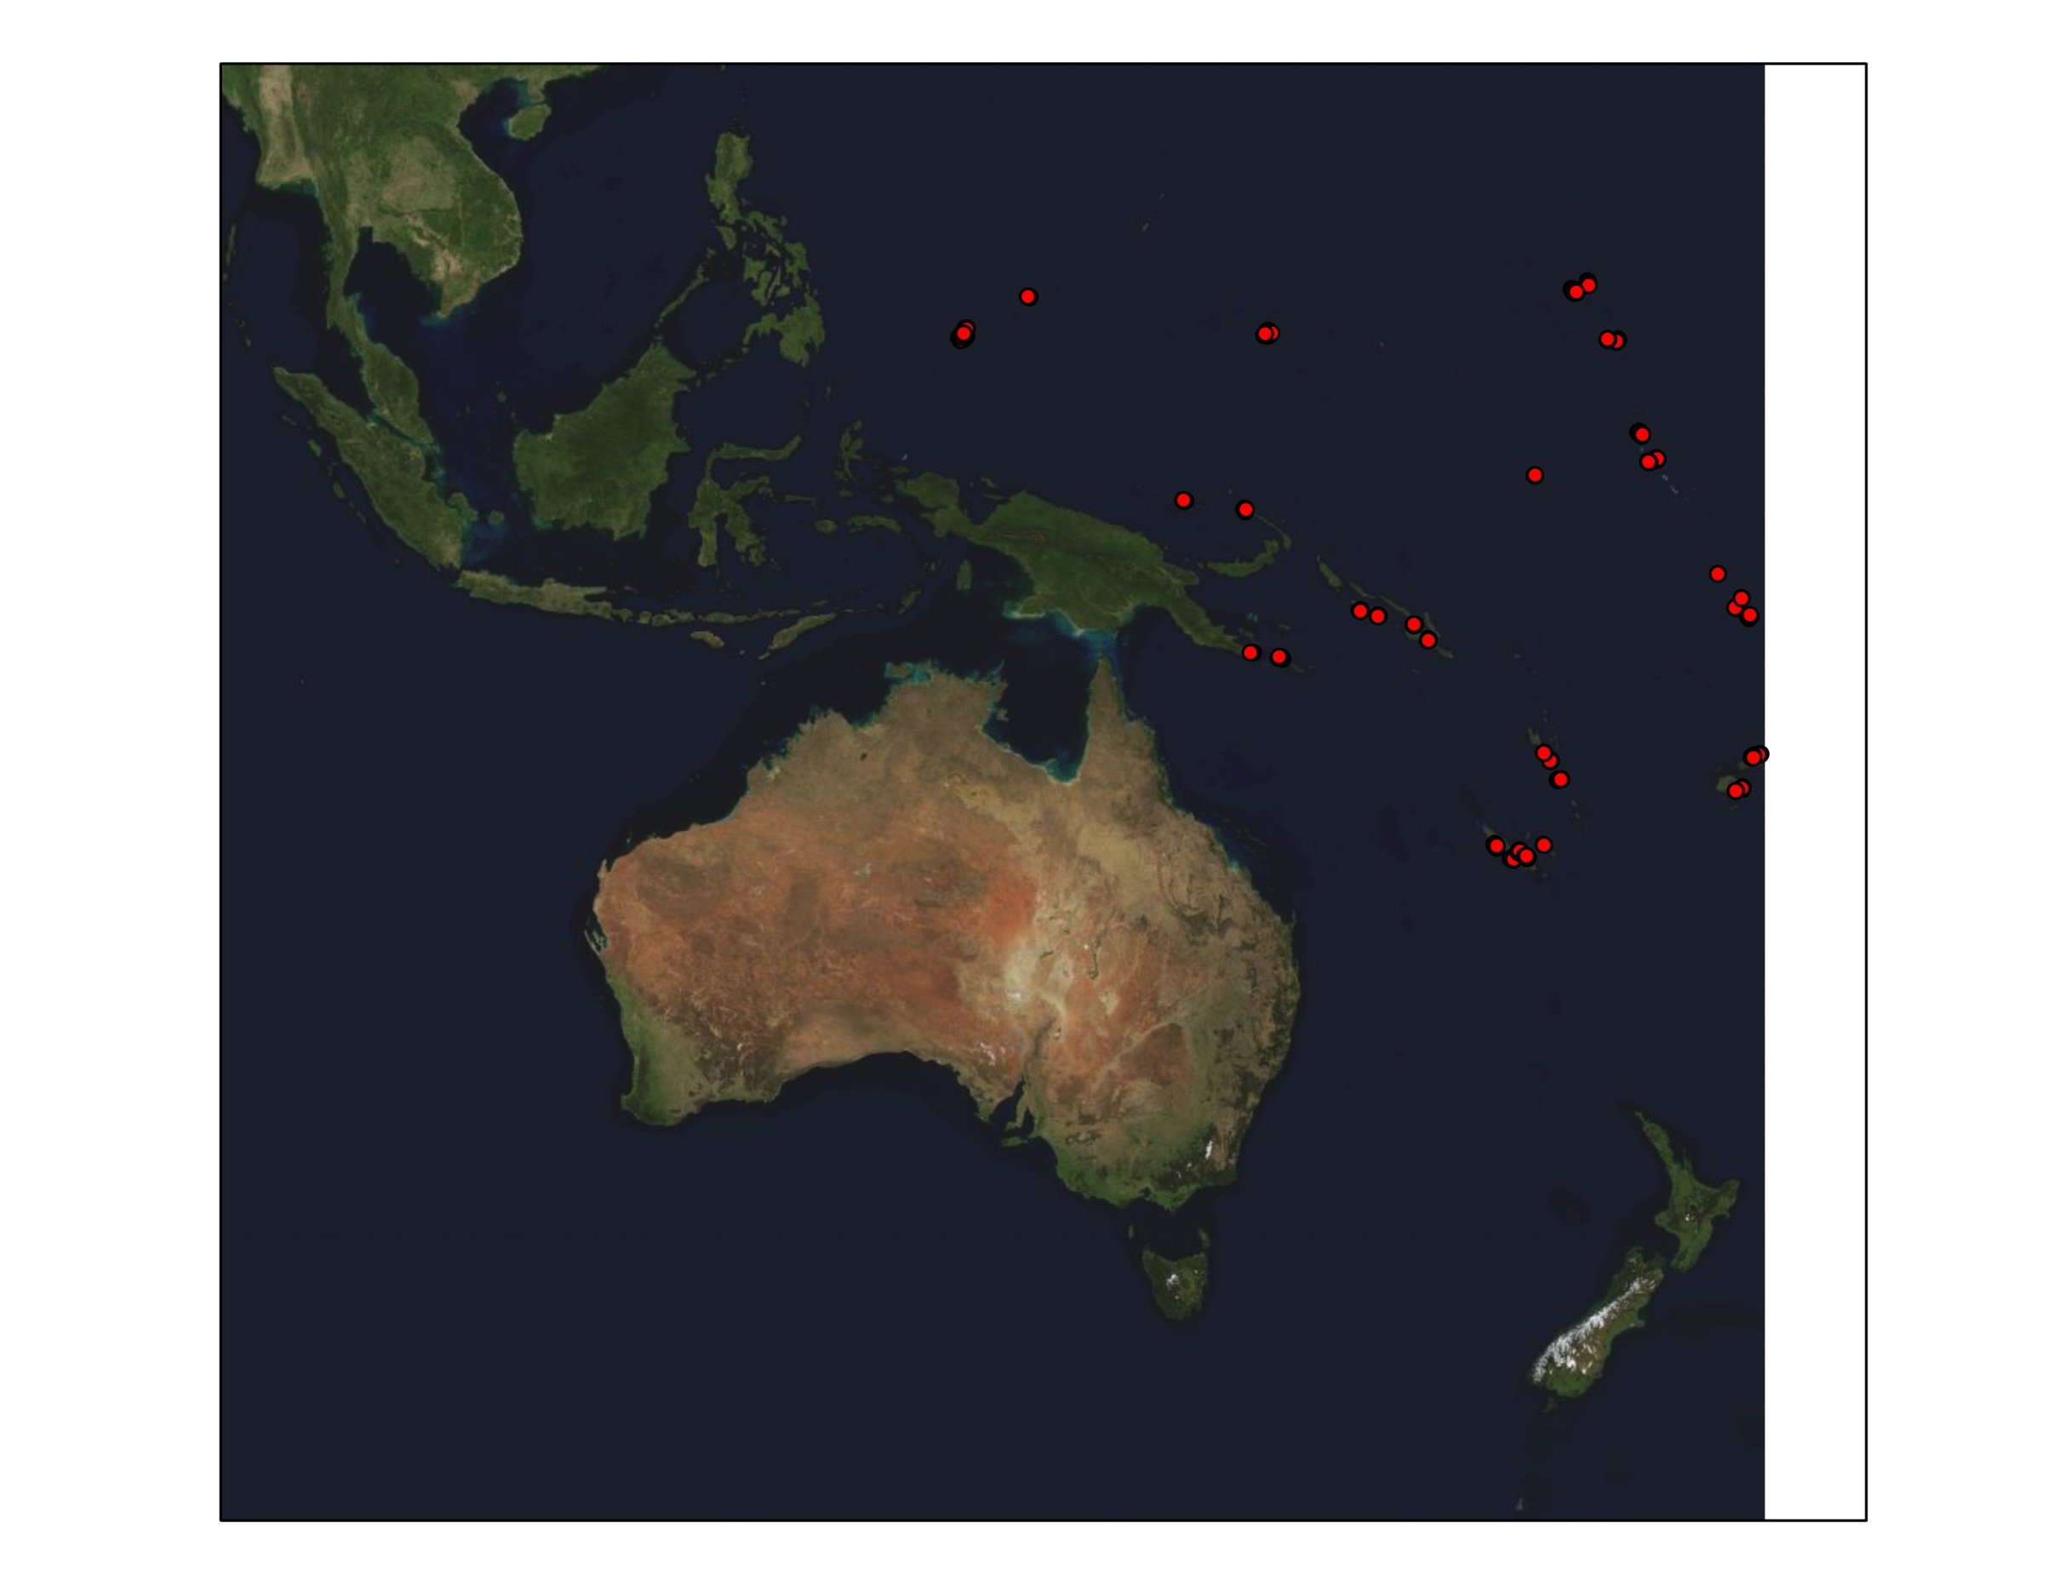
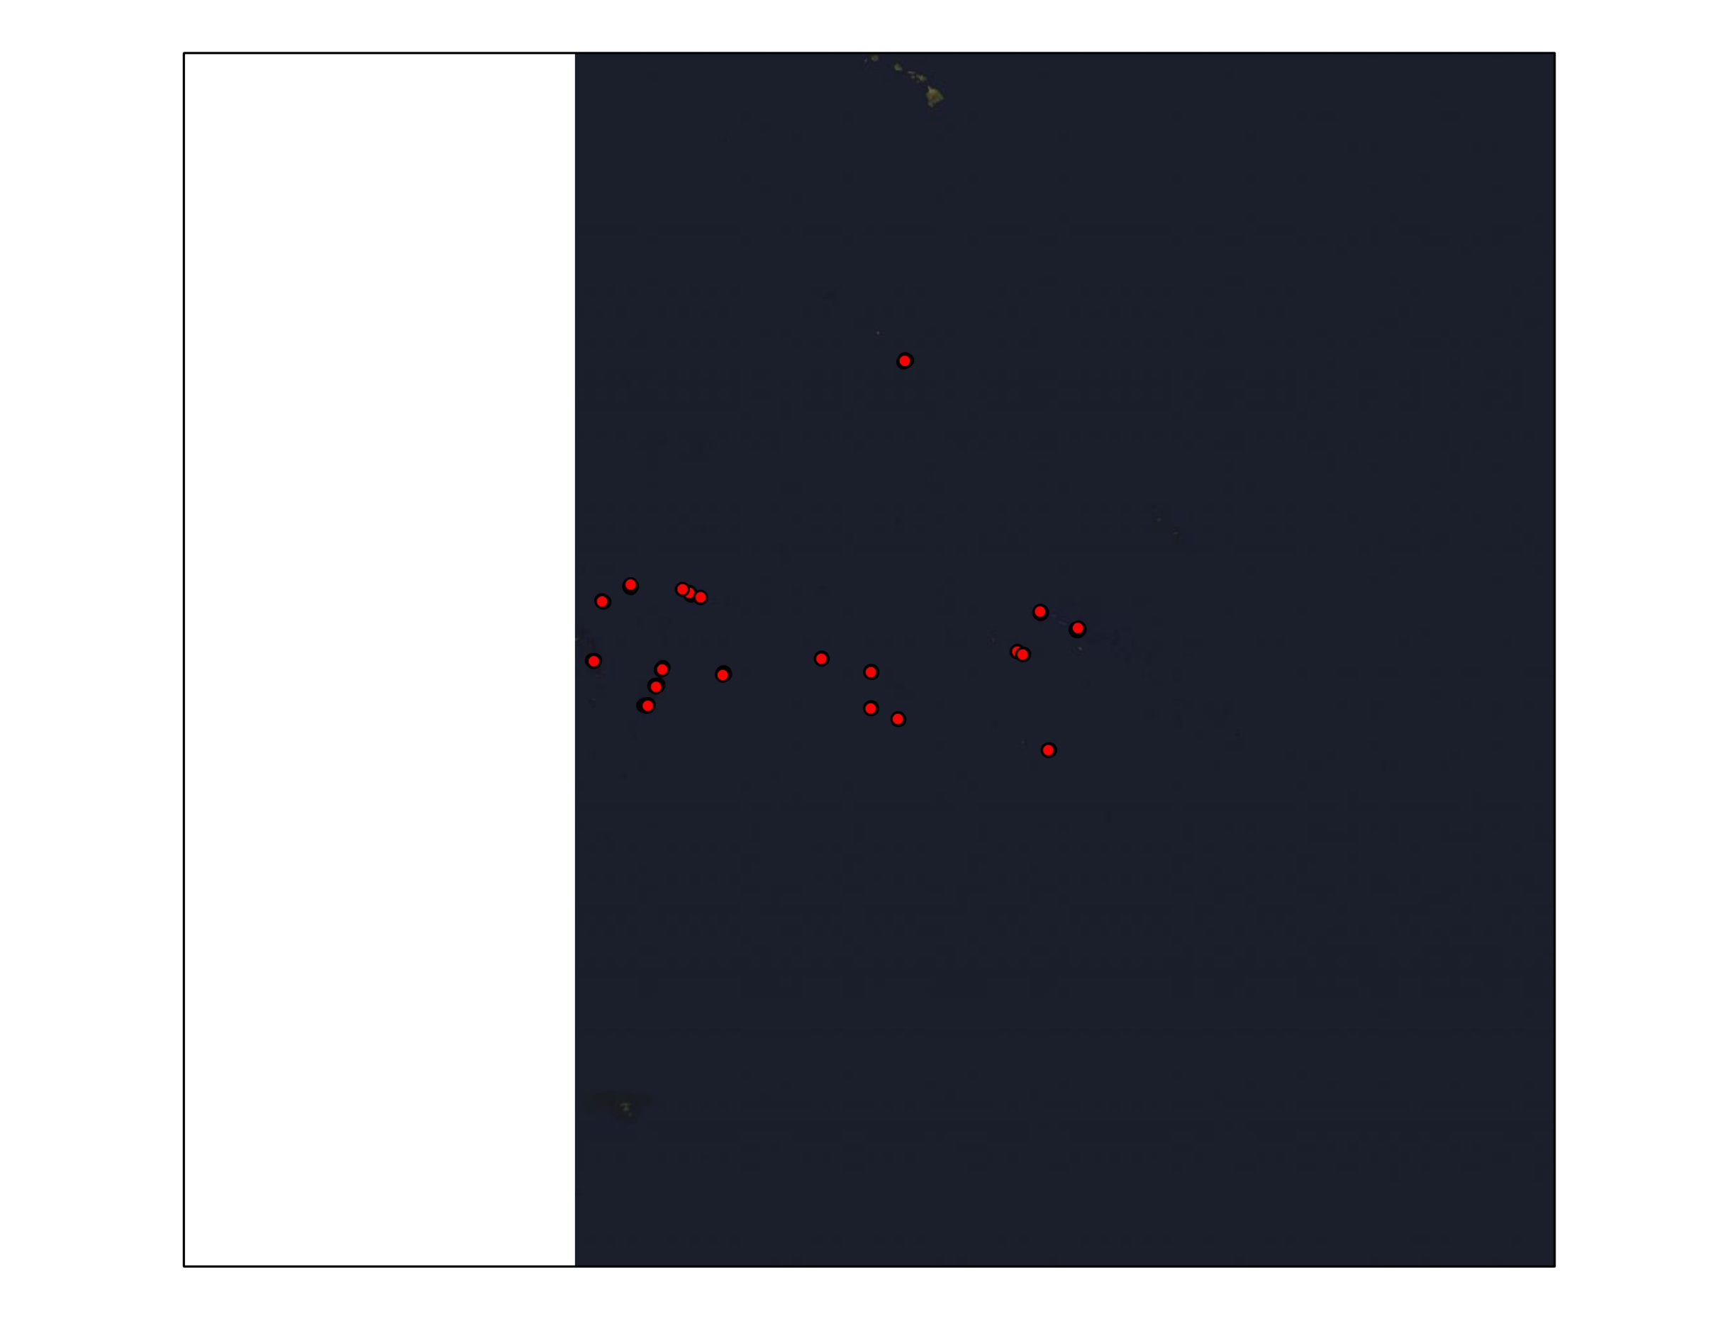
Underwater Visual Surveys
Fish abundance counts and benthic surveys conducted from 2002 - 2007
  Standardized 50m transects
  Distance based sampling (optimized transect width)
  63 communities across 17 countries (n = 646)
  Outer reef slopes
  20 families identified to species level (mostly targeted species)
  3 Trophic groups (Sharks, Carnivores, and Herbivores)
Micronesia
Polynesia
Melanesia
Notes:
6

Slide 7
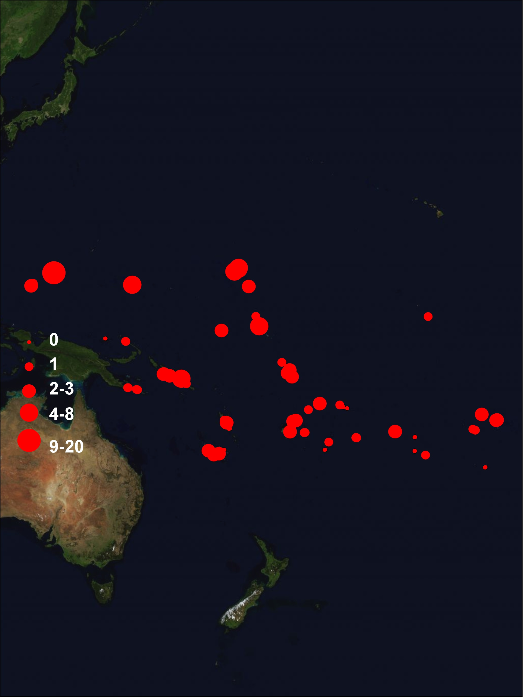
Reef Shark Abundance Counts (7 species)
Notes:
7
Variability in counts, but high zero inflation
Thus, here we used logistic regression to determine the distribution of reef sharks throughout the pacific

Slide 8
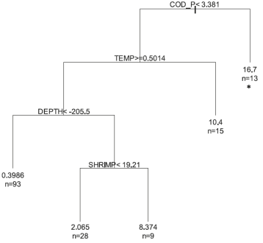
Important Variables: Boosted Regression Trees (BRT)
+
+
+
+
…
Construct a series of constrained trees until the model error is minimized
Logistic or classification models
4 models (grey, blacktip, whitetip and all reef sharks)
Determines relative influence of variables
Habitat Variables (reef type, current strength, slope, island type, depth, visibility and complexity)
Benthic Variables (coral, turf and macro algae cover)
Human Demographic Variables (distance to population center and number of people within 20 km)
Notes:
8

Slide 9
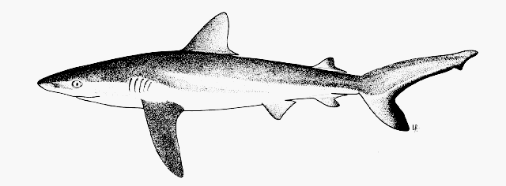
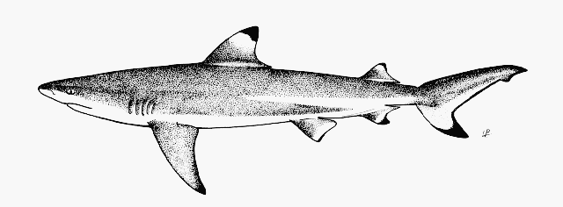
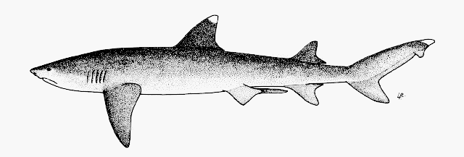
Influential Variables for Shark Distribution
Number of People within 20 Km
Distance to Population Center
Coral Cover
Depth
Visibility
Habitat Complexity
Macro Algae Cover
Turf Algae Cover
Number of People within 20 Km
Distance to Population Center
Coral Cover
Depth
Visibility
Habitat Complexity
Atoll Island
Notes:
9

Slide 10
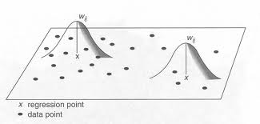
How does space influence these relationships?
Logistic GWR (Local Regression)
  Series of predictions across a geographic surface
  Kernel with an optimized fixed bandwidth (determined by cross-validation)
  Better fit of models compared to global regression (GLM)
  Get local r-squared values and coefficients
Notes:
Sampling. Will not spend too much time here. Information is online.

Slide 11
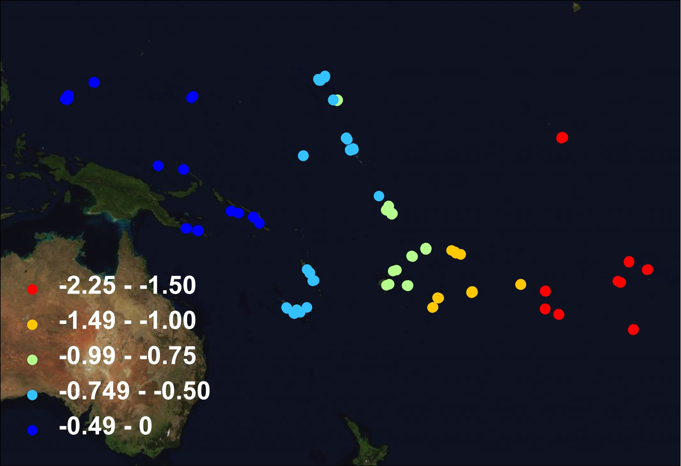
Logistic GWR: All sharks & humans within 20 km
Notes:
Remote means different things in the West and Eastern Pacific
Perhaps the human demography is not a well suited proxy for human activity for the Western Pacific

Slide 12
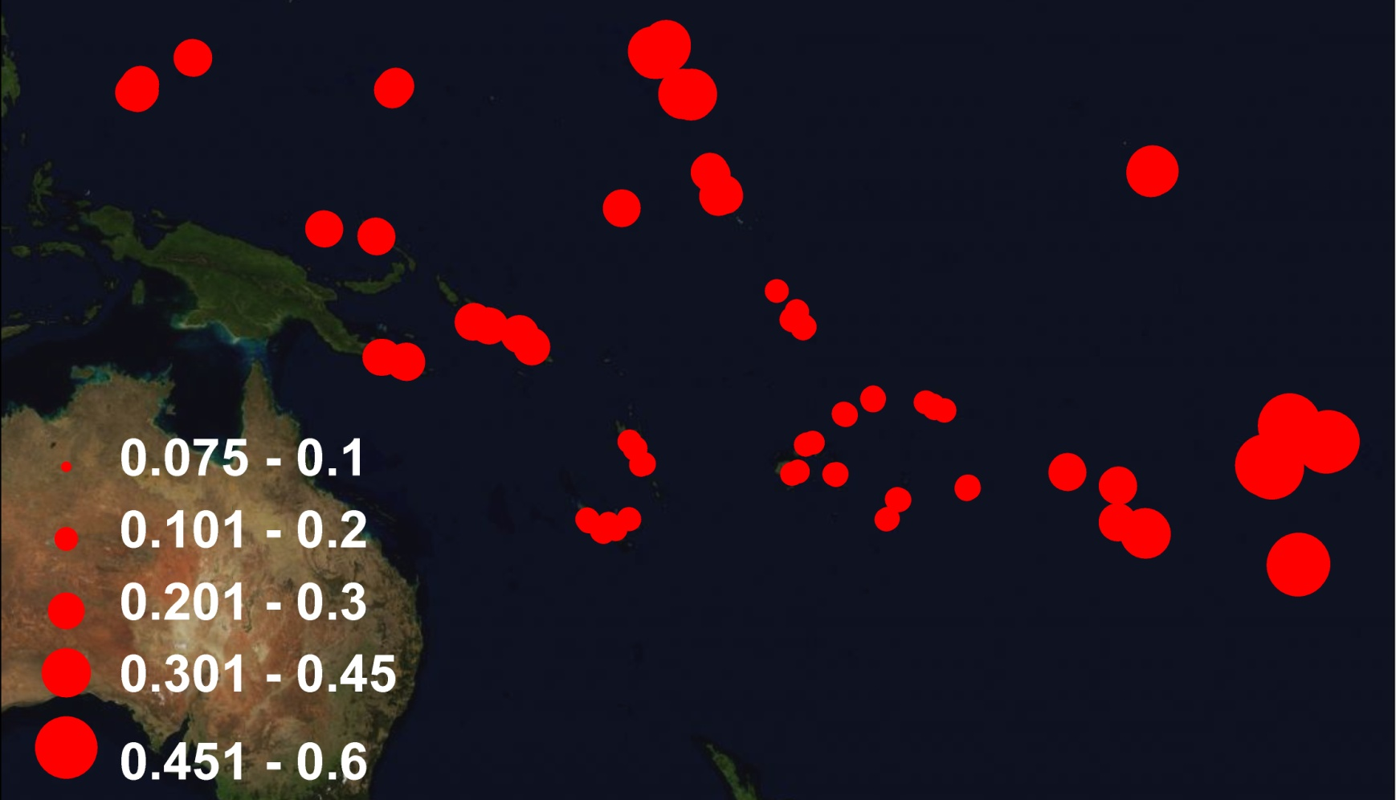
Logistic GWR: Local R² Values (All Sharks)
Notes:
R2 values for the ALL Sharks Model

Slide 13

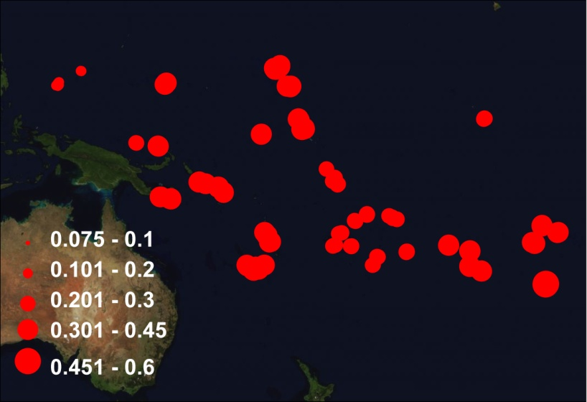
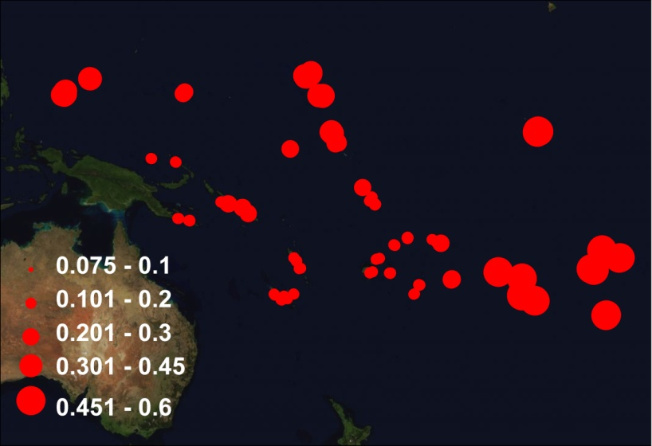
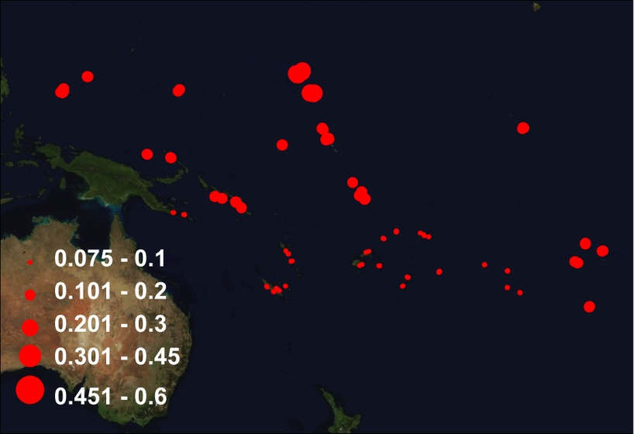
Logistic GWR: Local R² Values
All Sharks
Grey
Blacktip
Whitetip
Notes:
Local R2 for all 4 models
Note Whitetips the fit is poor for this model in comparison to the others

Slide 14

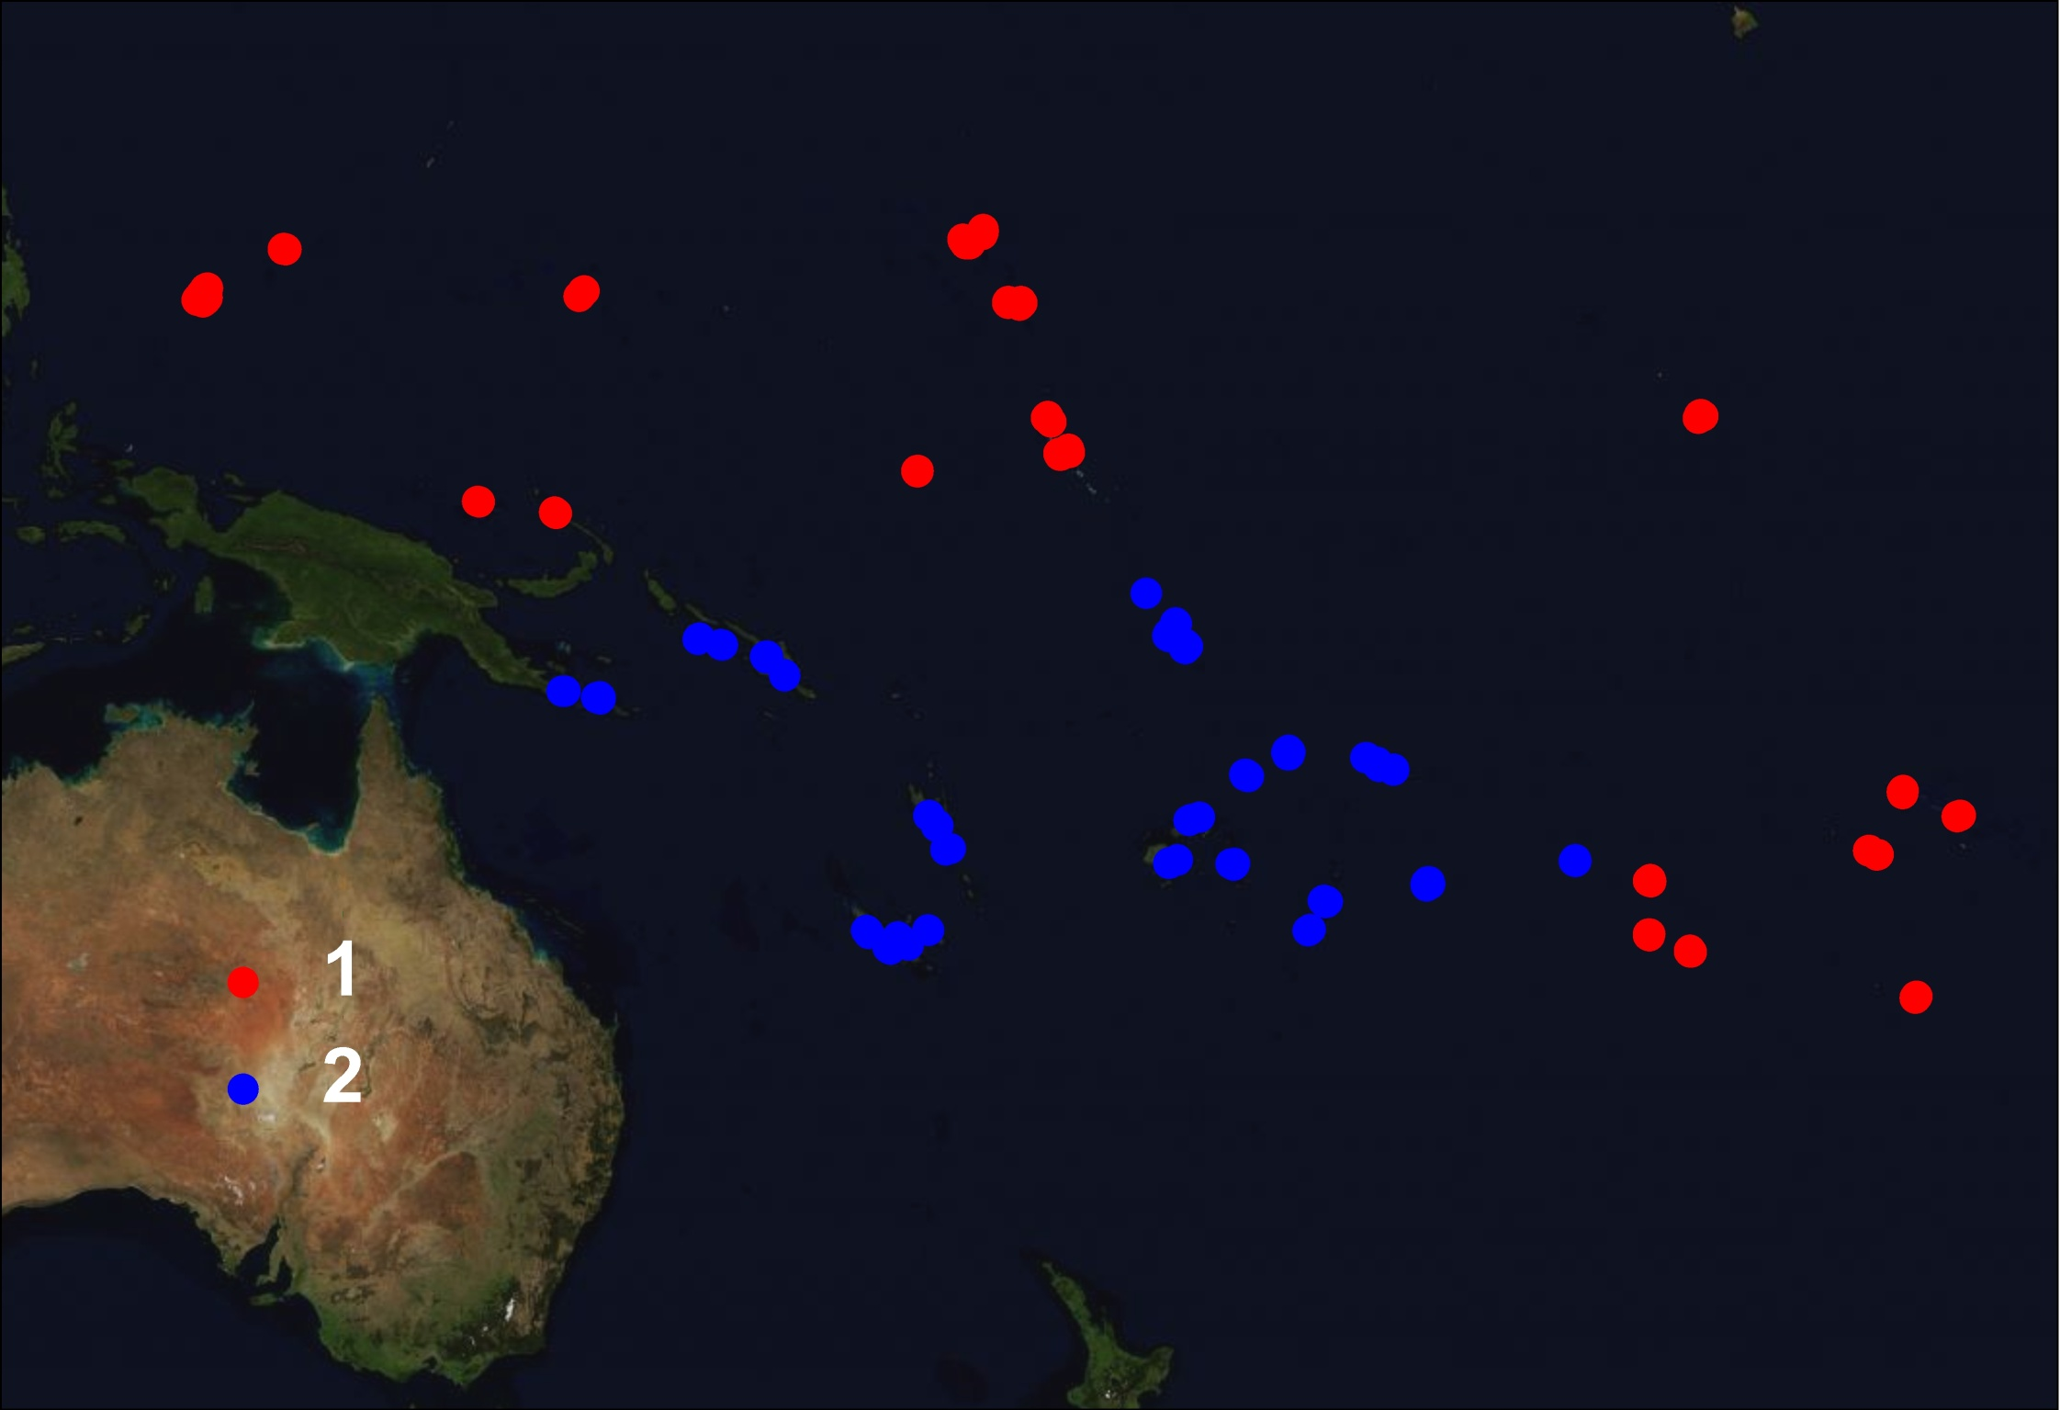
Logistic GWR: Local R² Values & k-means
R² = 0.30
R² = 0.15
Notes:
R2 values for the ALL Sharks Model

Slide 15
Influential Variables, Regions & Structuring Agents
Structural Equation Models (SEM): determine the significance and strength of human activity and top-order predator alterations on reef fish communities within the defined regions
Human Activity
Sharks
Habitat
Carnivores
Benthic
Herbivores

Slide 16
Structuring Agents & Interactions
R² = 0.15
R² = 0.30
Humans 20k
Humans 20k
-0.16
-0.32
Sharks
Sharks
-0.19
0.23
0.11
0.23
0.17
0.16
0.3
0.14
Carnivores
Carnivores
Depth
Coral
Depth
Coral
0.53
0.23
-0.13
-0.24
Herbivores
Herbivores
Significant
Non- Significant
Notes:
Need to add R2 values

Slide 17
Summary: Structuring Agents
Strong
Weak
Notes:
R2 values for the ALL Sharks Model

Slide 18
Summary
BRT: Human Activity (humans within 20km & distance to population center), Habitat (depth) and Benthic community (coral cover) variables are important to the distribution of reef sharks
GWR: the relationship between these variables (in particular Human Activity) and sharks is spatially dependent
Human demography is not a good proxy for human activity in all geographic regions
SEM: Regions in the Pacific with contrasting impacts by humans
Strong top-down (humans) and bottom-up (benthic) structuring occurs specific regions of the Pacific

Slide 19








Acknowledgements
Funding
Helpful Insights
Donald Jackson
Brian Shuter
Stewart Fotheringham
Places

